Slide 1

Secure our Application

Slide 2

Hashing Technique

Slide 3
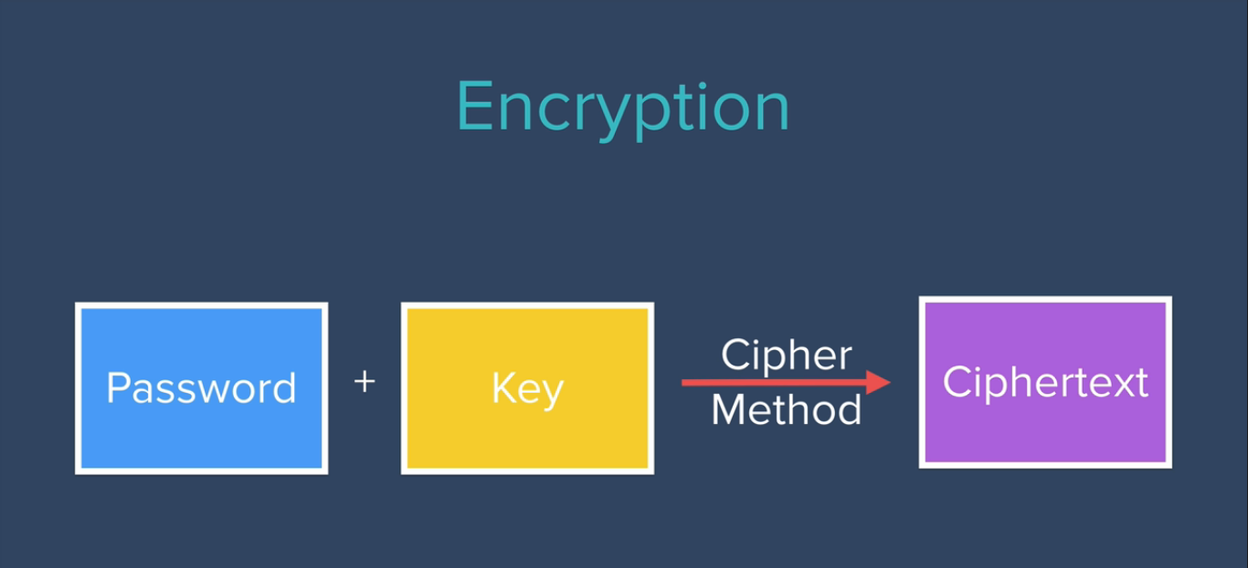
Understanding Encryption Working Principle

Slide 4
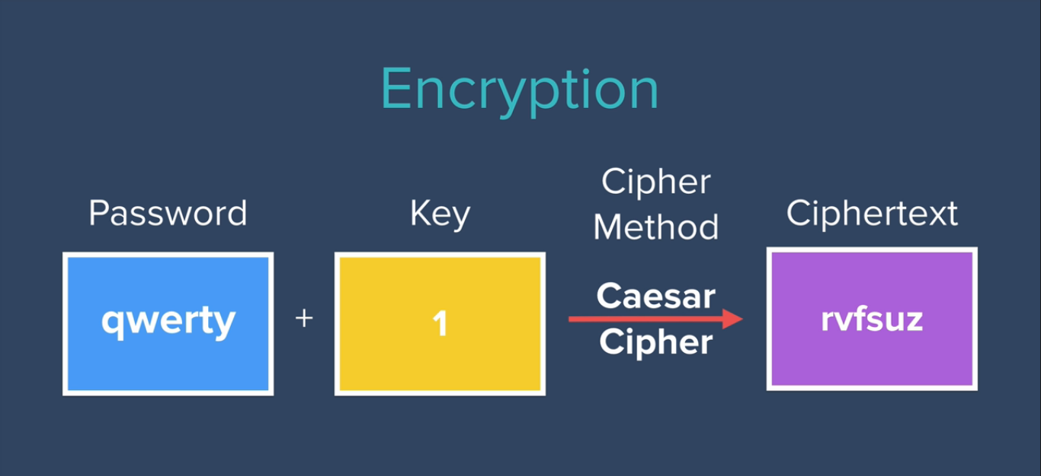
Understanding Encryption Working Principle: Example

Slide 5
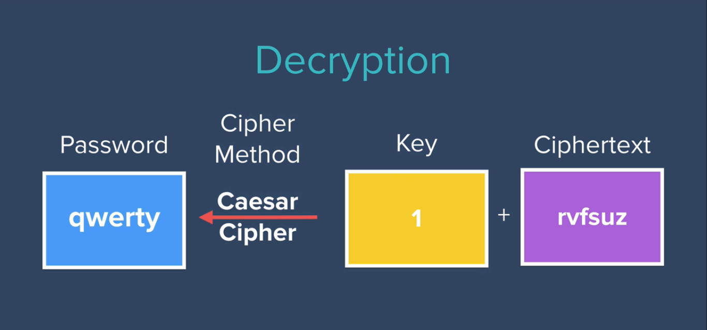
Understanding Decryption Working Principle: Example

Slide 6
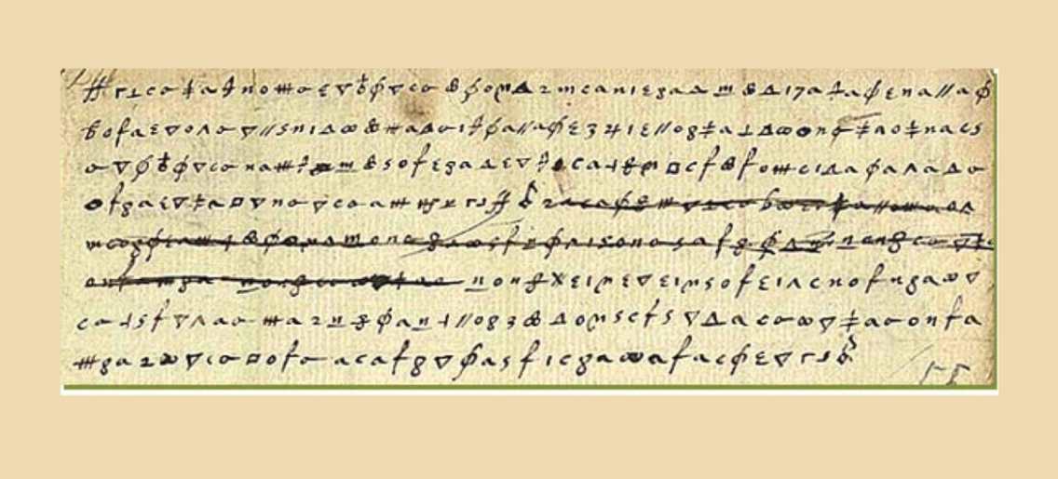
Understanding History of Cipher Text

Slide 7
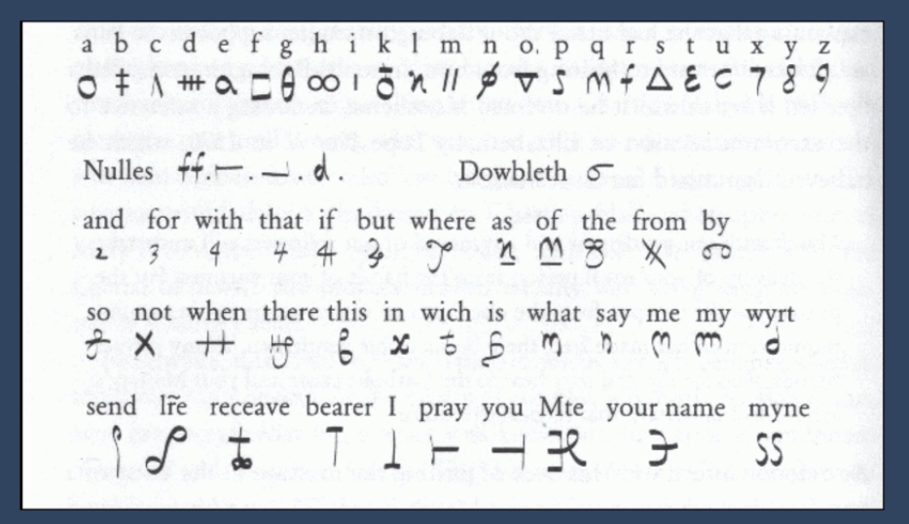
Understanding History of Cipher Text

Slide 8

Understanding History of Cipher Text

Slide 9

Understanding Hashing Principle

Slide 10
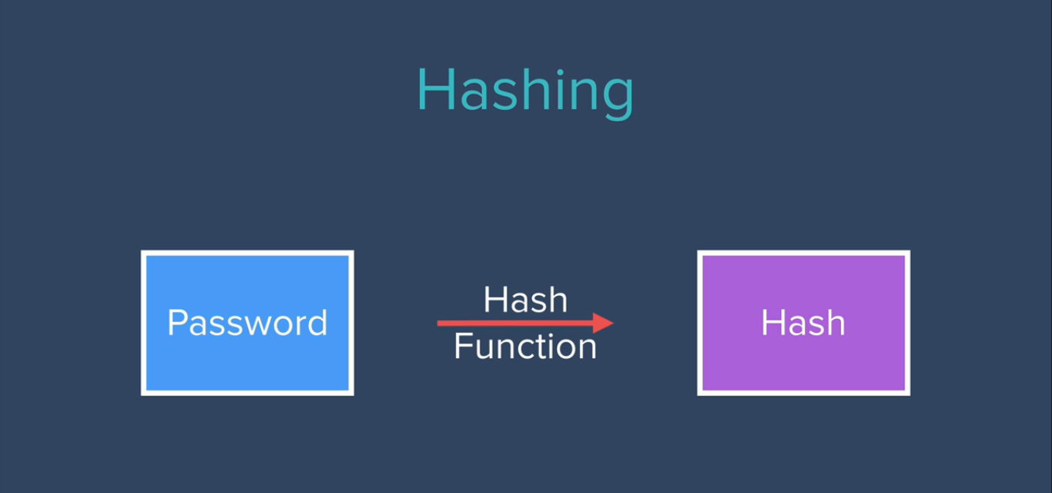
Understanding Hashing Principle

Slide 11
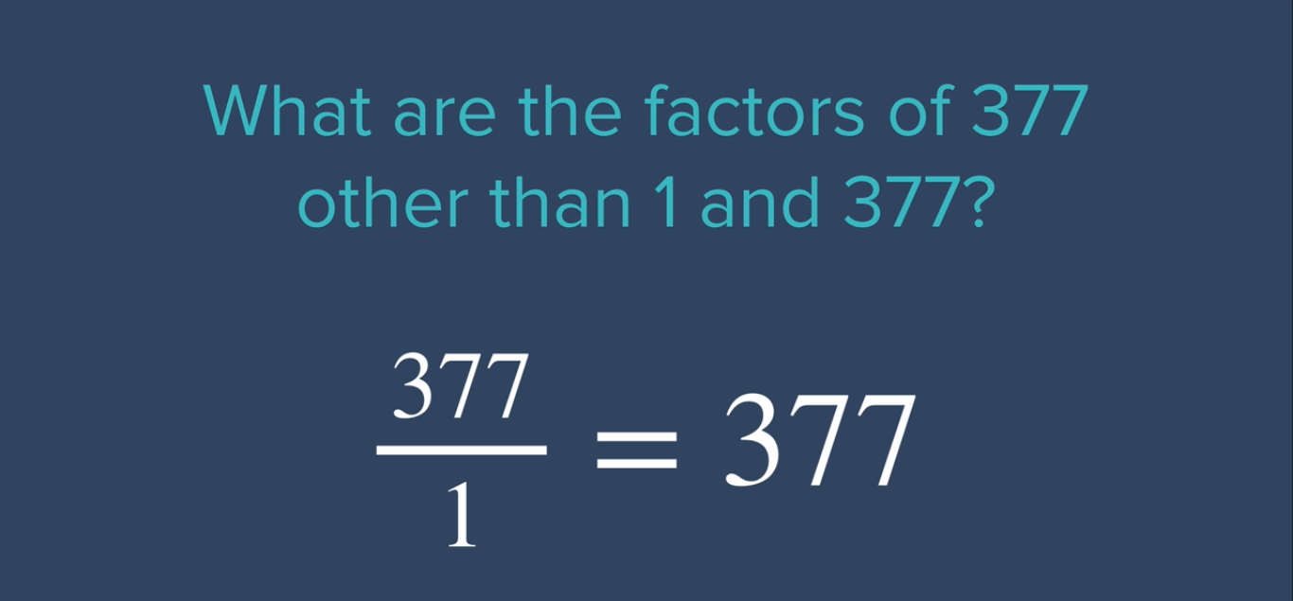
Understanding Hashing Principle: Example

Slide 12
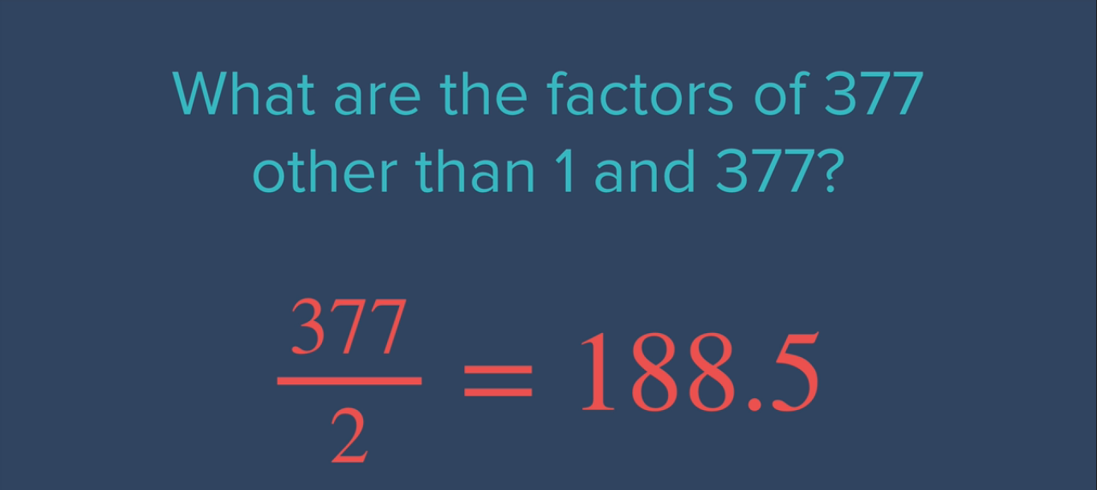
Understanding Hashing Principle: Example

Slide 13
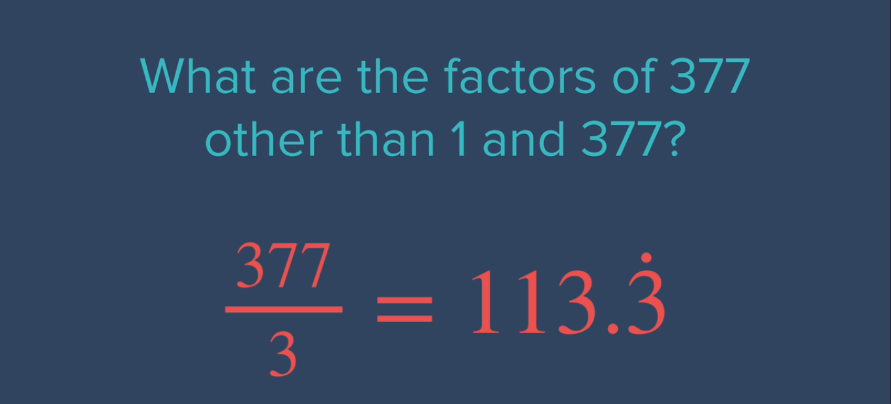
Understanding Hashing Principle: Example

Slide 14
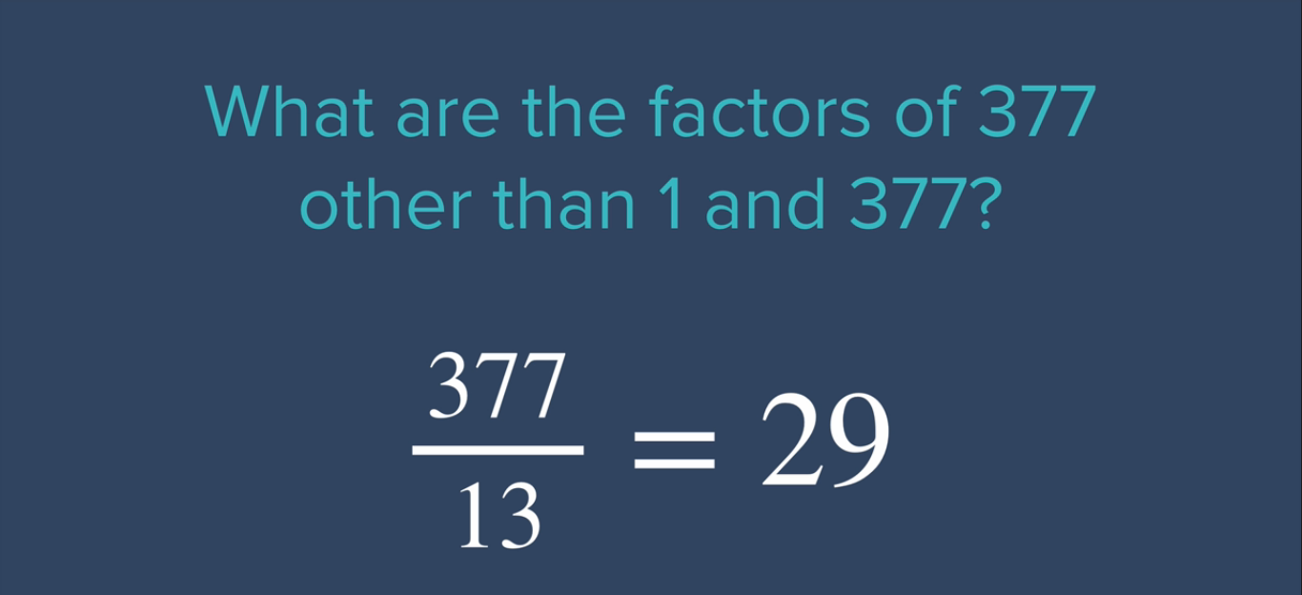
Understanding Hashing Principle: Example

Slide 15
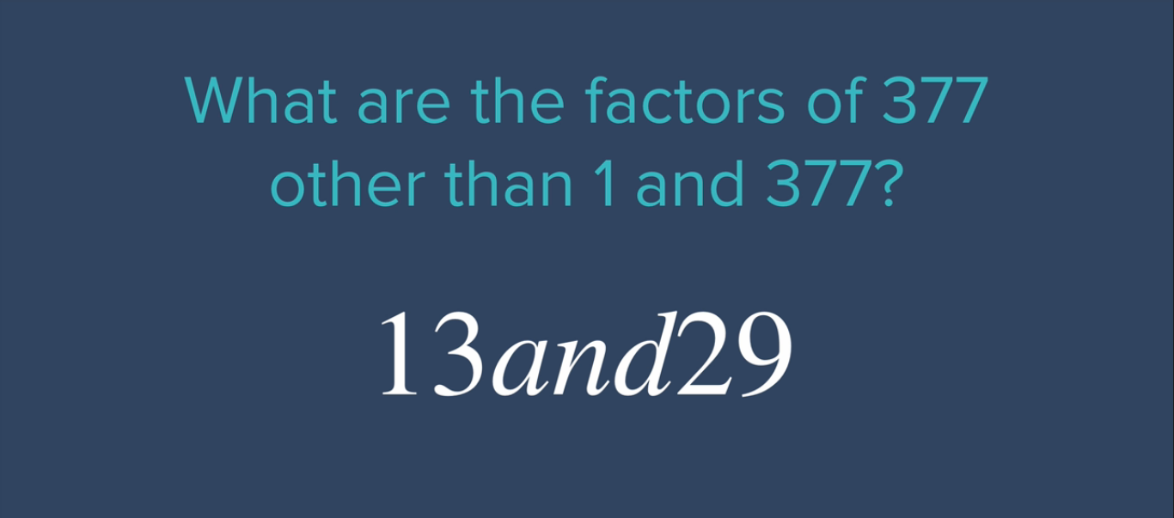
Understanding Hashing Principle: Example

Slide 16
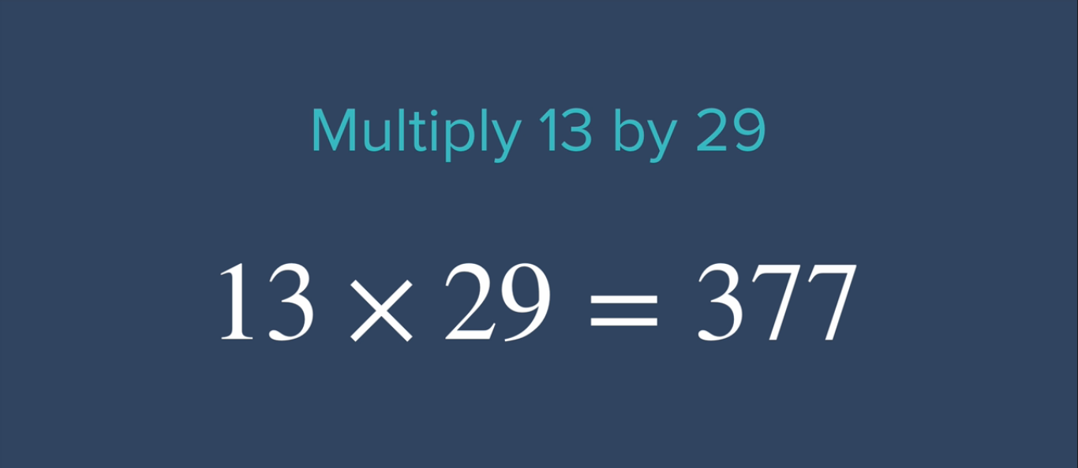
Understanding Hashing Principle: Example

Slide 17
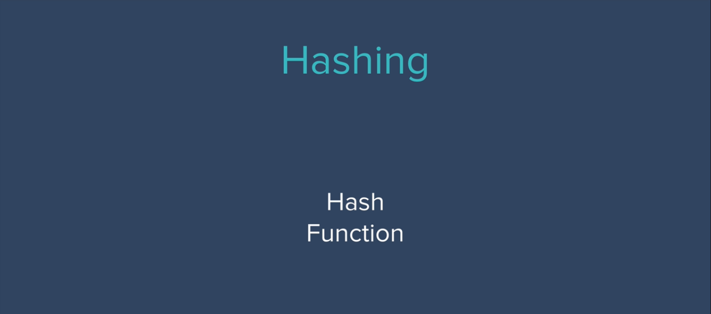
Understanding Hashing Principle

Slide 18
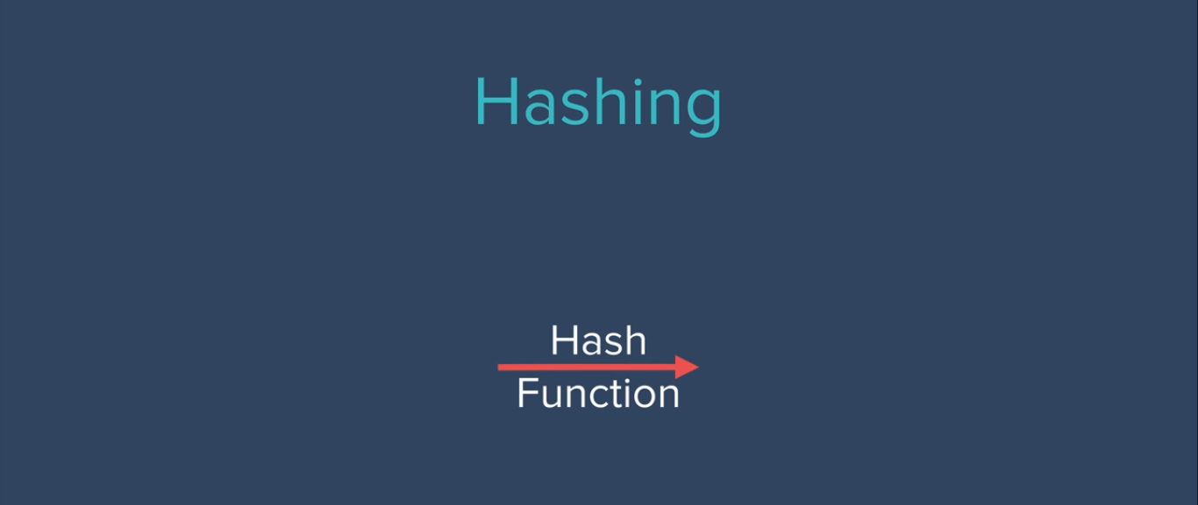
Hashing Forward only no backward

Slide 19
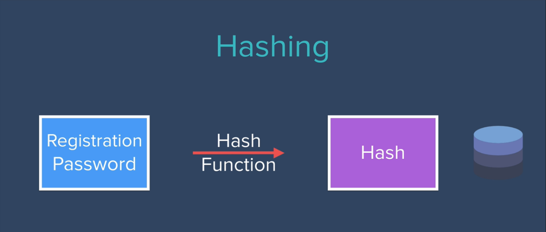
Hashing Working Principle: Example

Slide 20
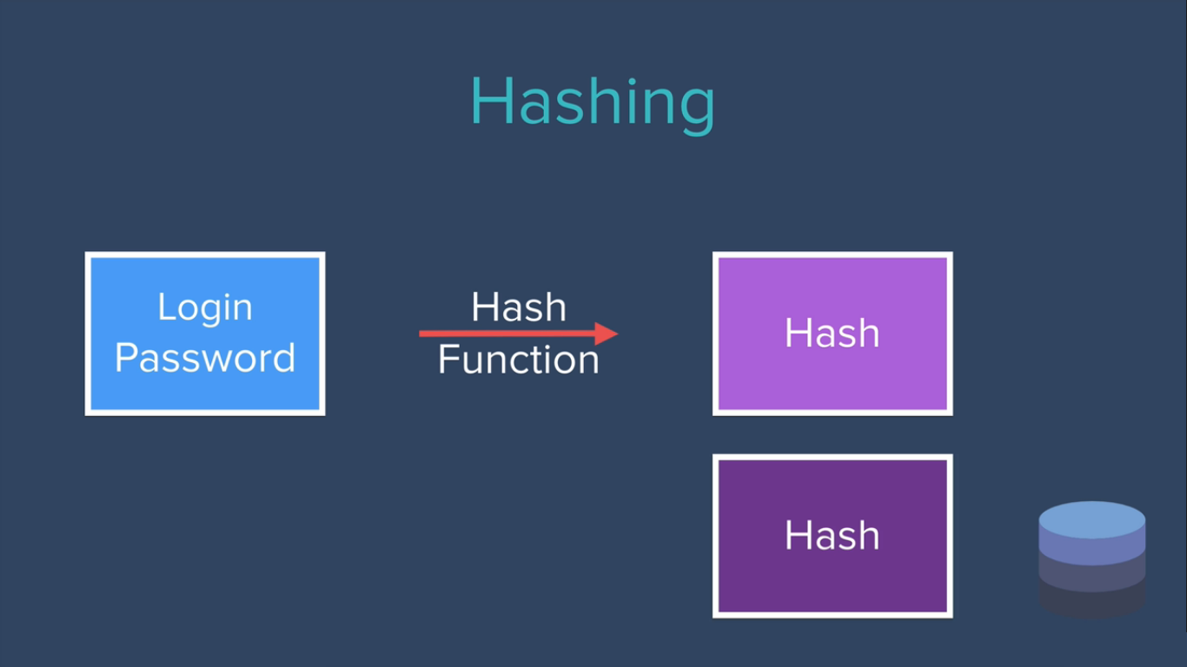
Hashing Working Principle: Example

Slide 21
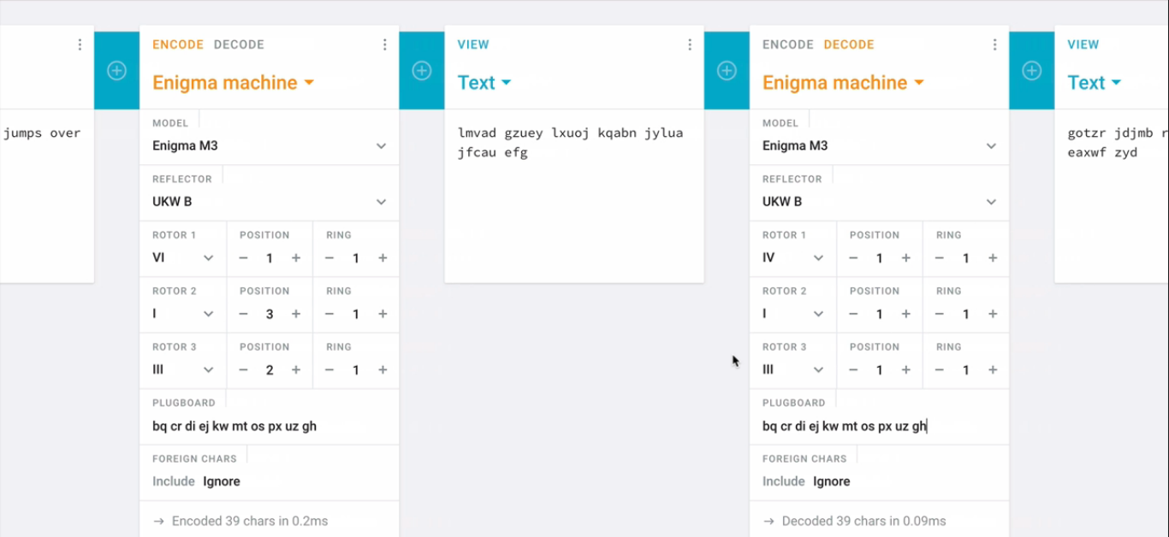
How Enigma Works ? Example

Slide 22
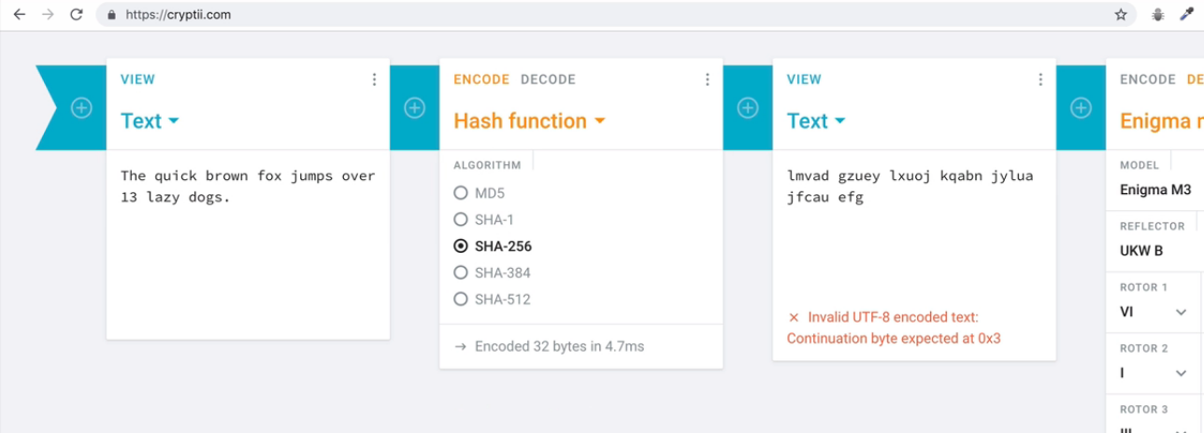
How Hashing Works ? Example

Slide 23
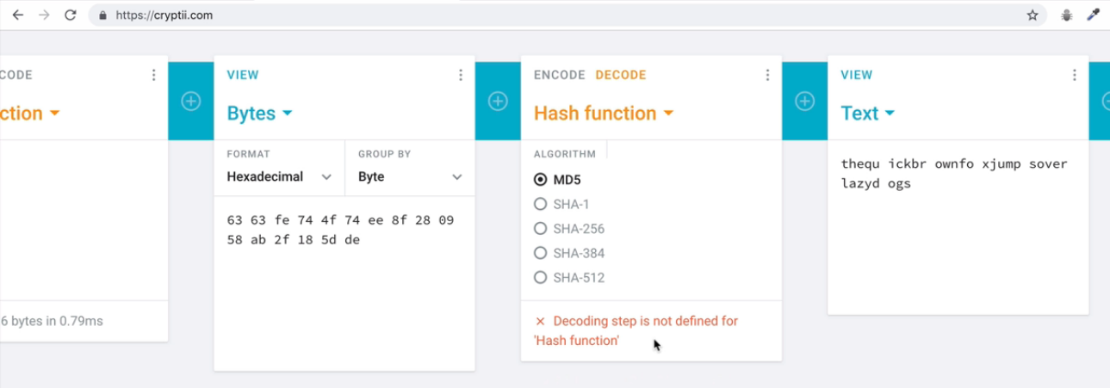
How Hashing Works ? Example

Slide 24
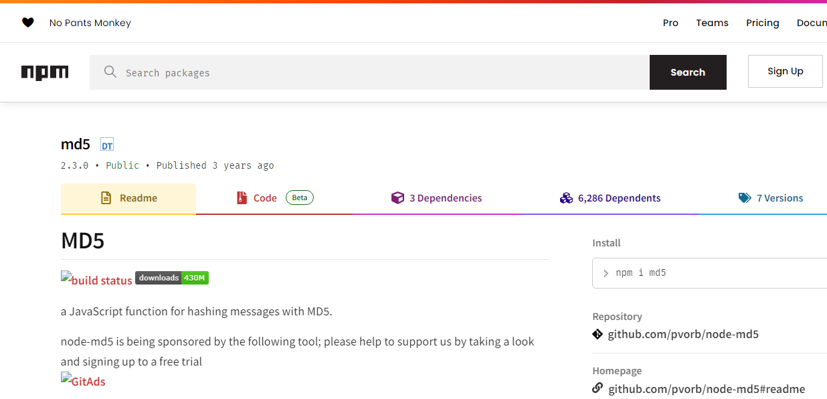
Implementing Hashing using npm package

Slide 25
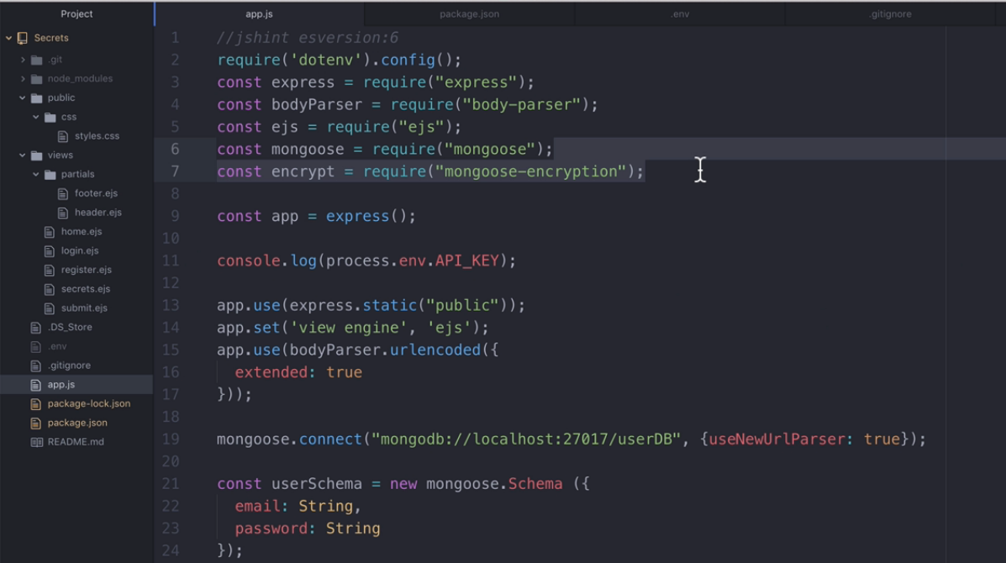
Remove previous encryption package

Slide 26
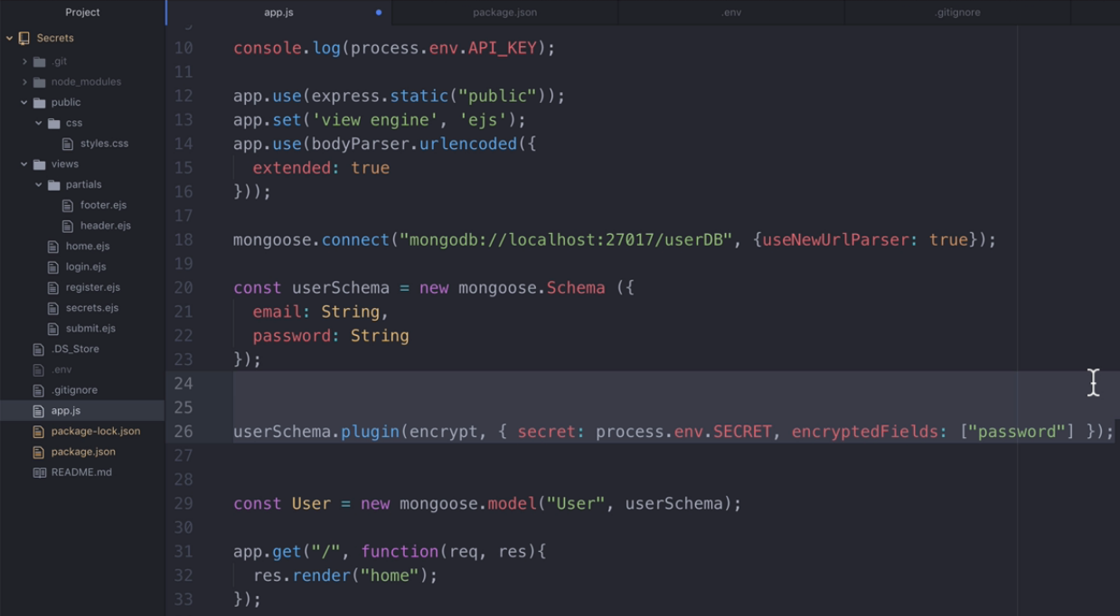
Remove previous encryption package plugins

Slide 27
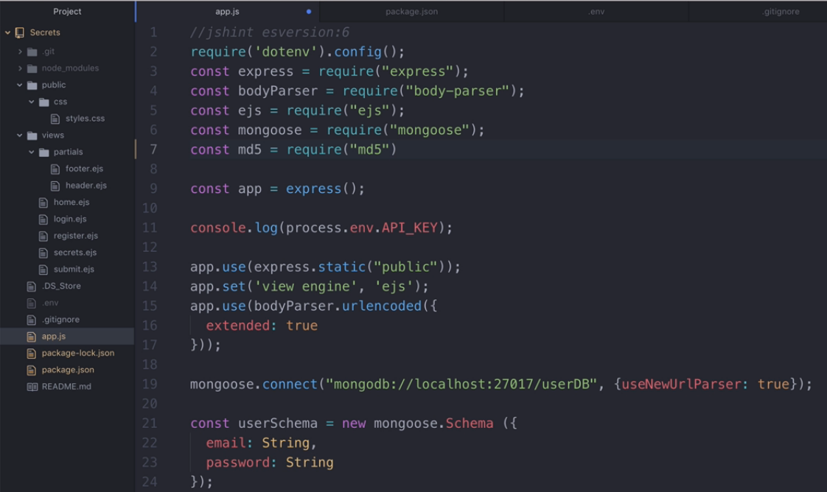
Import md5 package

Slide 28
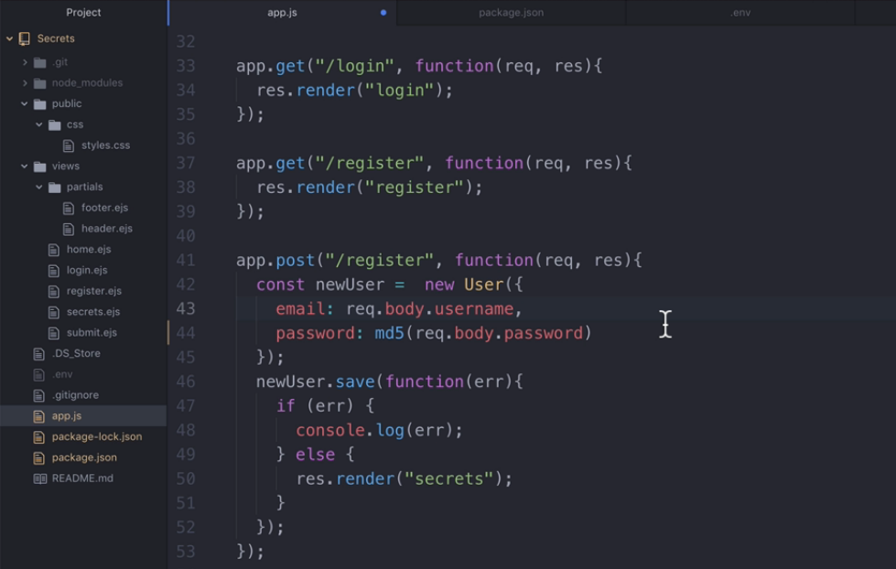
Covering password field using md5

Slide 29

Home Route

Slide 30
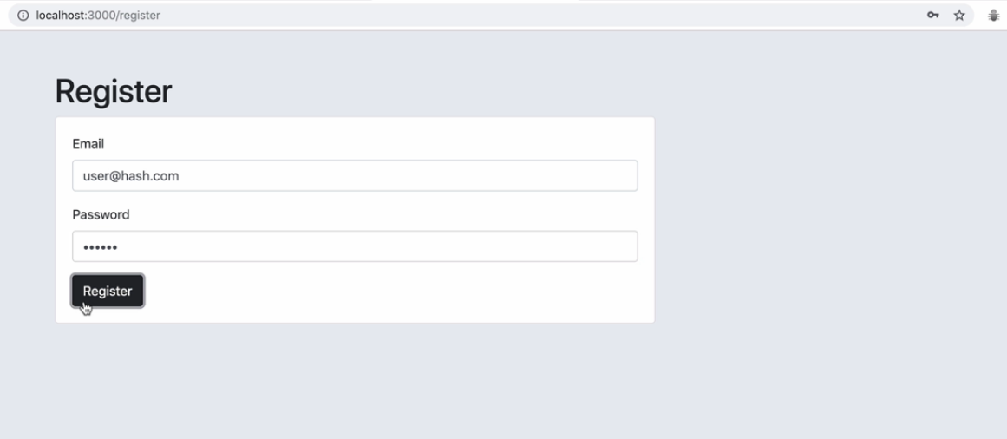
Password is 123456

Slide 31

Register Route-Successful Page

Slide 32
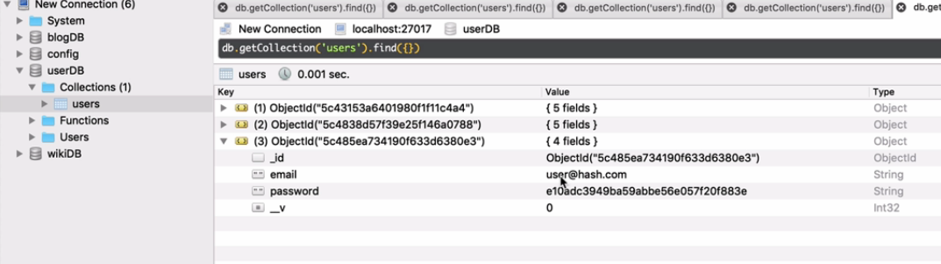
Checking password field is hashed or not

Slide 33
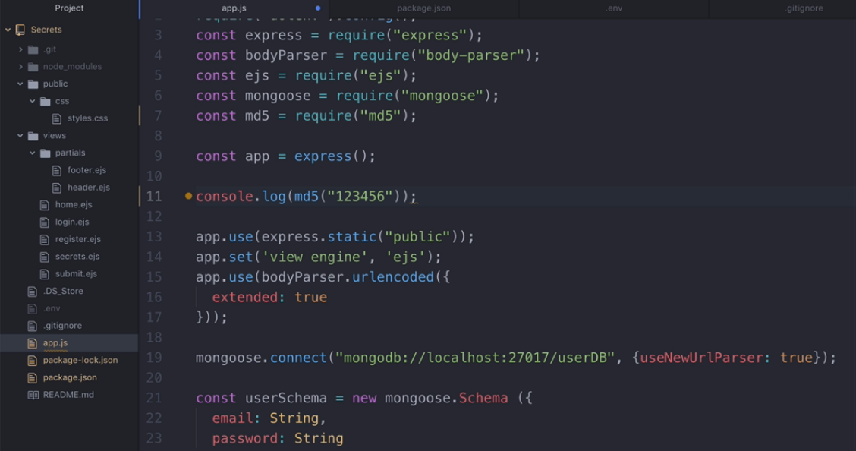
Checking at console whether hashed password is equal to
hashed password at DB

Slide 34
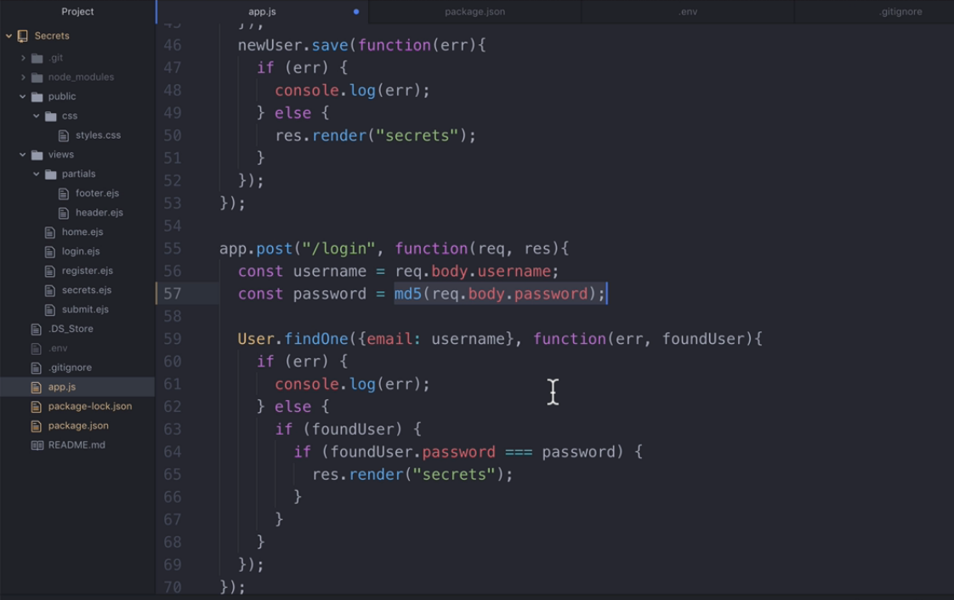
Covering password field using md5 at login

Slide 35
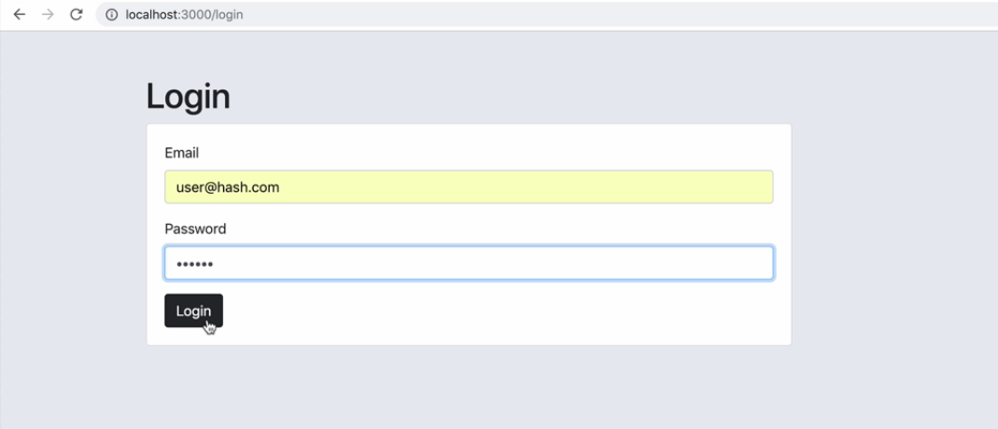
Login Route

Slide 36

Login Route-Successful Page

